Slide 1

Analyzing the COVID-15
Pandemic through Data Science: A Python-based Project

Slide 2

Introduction
Welcome to the presentation on "Analyzing the Impact of COVID-19."COVID-19 has had profound effects globally, and understanding its impact is crucial.This project utilizes data science techniques in Python, including NumPy, Pandas, Matplotlib, and Seaborn.

Slide 3

Data Collection
Data source : KAGGLE (an online community of data scientists and machine learning engineers. Kaggle allows users to ﬁnd datasets they want to use in building AI models, publish datasets, work with other data scientists and machine learning engineers, and enter competitions to solve data science challenges.)

Slide 4

Data Preprocessing
Cleaning: Handling missing values, removing duplicates.
Transformation: Date format conversion, data aggregation.
Importance: Ensures data quality for accurate analysis.

Slide 5

Exploratory Data Analysis
Libraries Used: Pandas, Matplotlib, Seaborn.
Visualizations: Time series plots, histograms, heatmaps.
Insights: Trends, patterns, outliers.

Slide 6

Statistical Modeling
Techniques Used: Descriptive statistics,
hypothesis testing,
linear NumPy,
regression.Libraries Utilized: Pandas,
Matplotlib.Approach:Descriptive Statistics: Utilize NumPy and Pandas to calculate mean, median, standard deviation, etc., providing insights into the distribution of COVID-19
data.Hypothesis Testing: Conduct t-
using NumPy and
tests or ANOVA
Pandas to assess the signiﬁcance of interventions or differences in COVID-19 metrics across different groups.

Slide 7





Geospatial Analysis
Geospatial analysis allows for
and of COVID-19 data, providing insights into
and of the pandemic.

Slide 8



Ethical Considerations
When dealing with sensitive health data, it's important to consider ,
, and
of the analysis and its potential impact
on public policy.

Slide 9
VISUALIZATION OF RESULTS

Slide 10
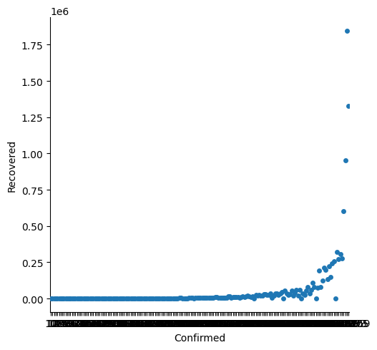
CONFIRMED VS RECOVERED

Slide 11
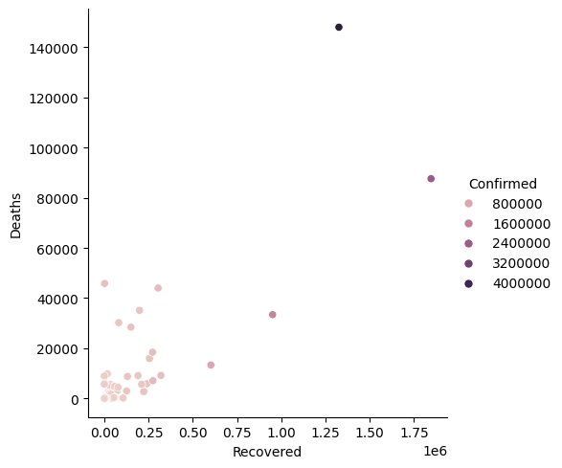
DEATHS VS RECOVERED

Slide 12
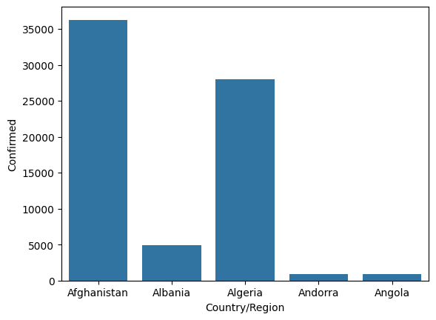
COUNTRY VS CONFIRMED CASES

Slide 13
DEATHS VS RECOVERED

Slide 14




Challenges and Limitations
Despite the power of data science, there are and analyzing the COVID-19 pandemic data, including
.
in
and

Slide 15


Recommendations for Future Work
To further enhance the analysis, future work could focus on
,
,
and
for data access.

Slide 16



Conclusion
In conclusion, this project demonstrates the power of
and in analyzing the COVID-19 pandemic. The insights gained can aid in making informed decisions and
shaping public health policies.
Key Findings: Impact on cases, deaths, economic indicators.Insights: Trends, correlations, predictive capabilities.

Slide 17
Thanks!
Do you have any questions?

